Slide 1
Getting Started
The Basics

Slide 2
Questions
What questions do you need to ask when thinking about starting a business?

Slide 3
LIFE CYCLE OF A BUSINESS
Every business goes through 4 basic stages before it reaches full maturity.
Stages 3 and 4 tend to continue to occur in mature companies.

Slide 4
LIFE CYCLE OF A BUSINESS
A. CONCEPTUAL STAGE
B. START-UP STAGE
C. STABILIZATION STAGE
D. GROWTH STAGE

Slide 5
Conceptual Stage
This stage of launching a business is a four-step process.
  1. Recognizing an opportunity
    Gap-an unsatisfied need or opportunity in the marketplace, produced by some kind of change that has taken place.
  2. Analyzing the idea
  3. Organizing the resources
  4. Mobilizing the resources

Slide 6
1. Recognizing the opportunity
  There is a difference between a great idea and a great opportunity. Provide an example.
  2. Analyzing the Idea
  Research potential market.
  Size in terms of amount of customers and dollars spent by customers
3. Organizing the Resources
  If the money-making potential is worth the risk of the initial cost of starting the business.
  Pricing is the most important aspect of this stage.
  Start-up costs

Slide 7
Financing –
Entrepreneurs provide much of the money needed themselves
Friends and relatives might invest
  Equity Financing is money exchanged for some share in the ownership of the company. Ex. Partnerships.
  A bank or other financial institution, this is considered to be debt financing.
4. Mobilizing the Resources
  At this stage, entrepreneurs actually prepare for the day to day running of the venture. i.e. Renting space or receiving inventory.

Slide 8
Royalty
A payment to an owner for the use of property, especially patents, copyrighted works, franchises or natural resources.
A royalty payment is made to the legal owner of a property, patent, copyrighted work or franchise by those who wish to make use of it for the purposes of generating revenue.

Slide 9
Equity
A stock or any other security representing an ownership interest.
30% equity in a business.

Slide 10
Idea or Opportunity
Market – pulled entrepreneurship – opportunity provides the pull that drives the development of ideas
Product –driven/services driven entrepreneurship – idea comes first and then the market opportunity

Slide 11
Market Size
Market Size is the amount of money being spent (per year) for a product or service.
- Market Size is always expressed using a dollar amount.
- To calculate Market Size you use the following formula:
(# people in target market) X ($ spent on product/service)
Example:
Joe is opening a shoe shine business in New York City.
Joe predicts that 765 people will use his service.
Per year, people spend $376 on this service.
The size of Joe’s market is $287,640
That is, there is $287,640 spent on this service per year

Slide 12
Your ideas
Think about your community. Describe three opportunities that are market – pulled.
What is the market need and how it can be satisfied?
Give examples of product driven.

Slide 13
Trends and Fads
Fad – temporary or short – term adjustments in the way we live.
  Ex. Pokemon, furbies, mood rings
  Trend - pattern or directions in the way something is changing
  Ex. Organic food, facebook, reality tv
  Forecast –prediction about the future

Slide 14
Turning Trends into Opportunities
When you spot what appears to be a trend, you have to ask yourself:
What caused this trend to start?
How long will it probably last?
What effects will it probably have?
What product or service might fill the needs generated by this trend, or how can I adapt my existing product or service to fit with this trend?

Slide 15
Trends- What are some trends in the following areas?
Education
Entertainment
Health
Services

Slide 16
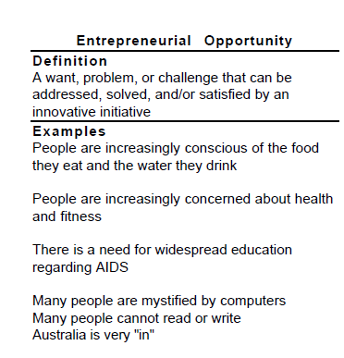
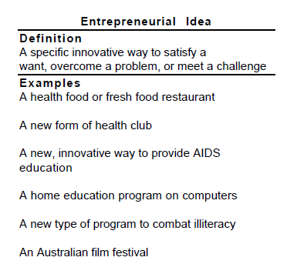
Responding to an entrepreneurial opportunity

Slide 17
http://www.cbc.ca/news/business/amazon-go-grocery-store-1.3883115
http://www.cbc.ca/news/business/online-retailers-open-regular-stores-1.3948652

Slide 18
Invention and Innovation
Invention – the creation of something new. Something that has never existed or tried before.
Innovation – change in something that already exists
Notes:
Invention- telephone, car, goalie mask
Innovation – flat top stove,

Slide 19
To do: Research
Can You…
  List 5 inventions and 5 corresponding innovations:
Inventions: Innovations:
Then-Your Innovation
Think of a common object, such as an aluminum or plastic bottle.
Identify as many possible alternative uses as you can think of for the object.

Slide 20
Then-
Which ideas are viable, or could be a possible success?
Assess your ideas on:
  Realistic
  Satisfies a genuine need/want
  Will be demanded by a large number of consumers
  Will be relatively inexpensive and simple to produce.
  Who will be the target market?

Slide 21
Invention or Innovation?
Cell Phone
DVDs
Reversible clothing
Men’s skincare prod.
Lycra® or Gor-Tex®
I pods
Snowboard
On-Star Global Positioning System
Power bars
Scented markers

Slide 22
Invention
https://www.youtube.com/watch?v=7P468z0_C70
http://www.buddyrider.ca/
What do you think of this invention?

Slide 23
Your Innovation
Think of a common object, such as an aluminum or plastic bottle.
Identify as many possible alternative uses as you can think of for the object.

Slide 24
Your list
Which ideas are viable, or could be a possible success?
Assess your ideas on:
  Realistic
  Satisfies a genuine need/want
  Will be demanded by a large number of consumers
  Will be relatively inexpensive and simple to produce.
  Who will be the target market?

Slide 25
POP Challenge
What do you see and hear that makes John Nese a good entrepreneur ?
https://sodapopstop.com/media/msnbc-your-business-soda-pop-stop/
What opportunities did John Nese take advantage of?
http://www.sodapopstop.com/

Slide 26
Your pop challenge
Complete assignment

Slide 27
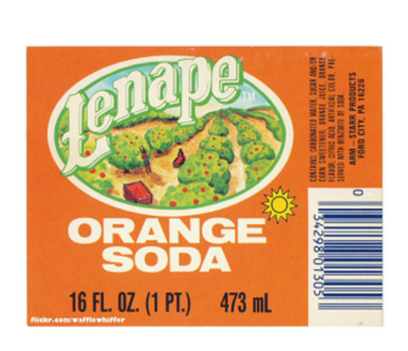
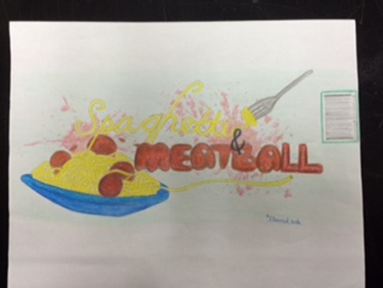

Slide 28
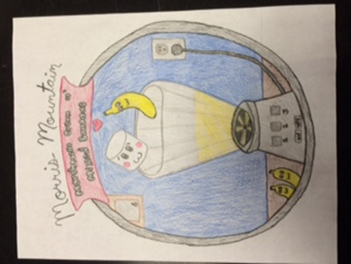
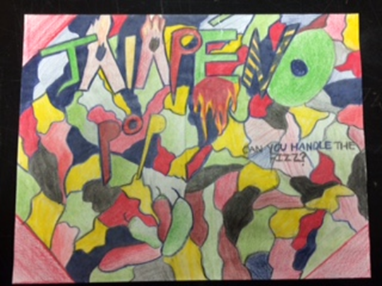

Slide 29
Protecting Your Ideas
Research the following
Patents
Copyrights
Trademark
Notes:
Anyone can apply for a patent, safe to discuss work
Copyright exists automatically when an original work is created; however, registration gives you a certificate that states that you are the owner, which can be used in court as evidence of ownership.

Slide 30
Patents – What is a patent?
https://www.youtube.com/watch?v=OFVoJhp3RN4
A government grant giving the right to exclude others from making, using or selling an invention. 20 years
It gives the inventor the exclusive right, for a limited period, to stop others from making, using or selling the inventor's product without the permission of the inventor.
Patents can take 2-3 years to be granted.
They can cost from $200 - $30,000!

Slide 31
Copyrights
  Provides protection for literary, artistic, dramatic or musical works (including computer programs), and three other subject matter known as: performance, sound recording, and communication signal.
  Coverage is worldwide and extends for the life of the creator + 50 years.
  Cost approx. $50/electronic application and $65/ manual application

Slide 32

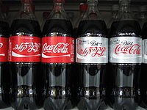

Trade-marks
Notes:
Original, distinct, unique. It's all about standing out.
Your trade-mark helps your customers distinguish your products and services from others in the marketplace
15 years

Slide 33
Trade-marks
Trade-marks are words, symbols or designs (or combinations of these) used to distinguish the goods or services of one person or company from those of another.
Legal ownership for 15 years and it is renewable every 15 years thereafter.
  Cost approx. $250/online and $300/manually. If successful, you pay another $200 for a certificate of registration.

Slide 34
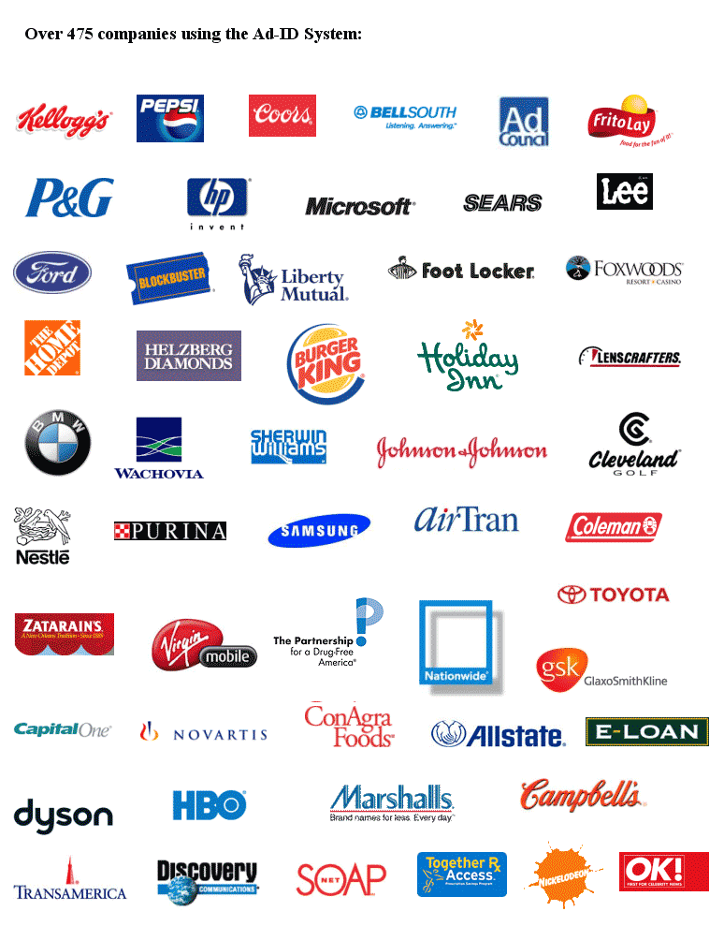

Slide 35
Market Research Studies
Market research studies are as different as the businesses they are made for, but most attempt to answer some fundamental questions:
  Is there a realistic market for my services or products?
  Who and where will my customers be?
  How many units can I sell?
  How much can I charge?
  Who is my competition and do I have any competitive advantages?
  Who will my suppliers be and how much will they charge?
  What credit terms are they likely to offer?
  Do I have ready access to my market and what is the cost associated with that?
  Will my business generate sufficient profit to justify the sacrifices which I’ll have to make?

Slide 36
Buyer Analysis
Who?
  Who purchases the product/service?
  Who pays for the product/service?
  Who uses or consumes the product?
What?
  What needs or wants do they seek to satisfy?
  What product features or attributes matter the most?
When?
  When do buyers search for and evaluate information to make informed choices?
  When is the product used or consumed?
  When is the product discarded?

Slide 37
Buyer Analysis
Where?
Where do buyers shop for the product?
How?
How do they pay for the purchase?
How do they use the product?
How do they decide on a particular purchase at a particular time?
Why?
Why do they want the product? Why do their choices differ?

Slide 38
Your Product and Service
What makes it special?
How will it be used?
How will the price be established?
What special service will you offer?
Who are your target customers?
Where will you be located?

Slide 39
Your Competition
Price strategy
Market segment
Distribution system
Customer service
Guarantees or warranties
Location
Advertising strategies

Slide 40
Competition Profile
Name | Product or service | Price | Quality | Quantity | Other (ex. Location, service
Jay’s gym shoes | Sneakers for running and cross training | Running shoes-$150 Cross trainers- $180 | Quality guarantee Staff to determine quality | Running shoes-200 Cross trainers- 150 pair | Wholesalers and retailers complain of late delivery Limited selection

Slide 41
Primary Research
Primary marketing research is collected for the first time. It is original and collected for a specific purpose, or to solve a specific problem.

Slide 42
How to Collect Primary Research
1. Interviews/Survey
2. Mystery shopping
3. Focus groups
4. Projective techniques
5. Product tests
6. Diaries

Slide 43
Secondary Research
Secondary marketing research, or desk research, already exist in one form or another. It is relatively cheap, and can be conducted quite quickly .
http://www.canadabusiness.ca/
https://www.retailcouncil.org/resources/industry-research/

Slide 44
For Your Pop
Develop questions for your target market. 4 questions
Develop a profile of your competition using previous example

Slide 45
Assignment
Choose two the following businesses in the Dalhousie/Campbellton/Bathurst area.
Decide what new product or service the business would like to offer.
Develop questions for the target market that will evaluate whether the product is viable or not.

Slide 46
Scenario- Answer the question
  Anywhere town
    Anywhere town is 20 km from Somewhere city (which has 80, 000 people)
    Population of Anywhere – 20, 000
    Average household income $70,000.
    Demographics (data on the characteristics of a human population such as gender, race, age, income)
      Majority of households are young married couple with 1-2 children.
      Most households have two incomes
      Anywhere town has:
        2 doctors, 1 Lawyer, 1 Tim Hortons, 1 McDonalds, 1 daycare (20 children)
        What kind of entrepreneurial opportunities are there?

Slide 47
Evaluating a Business or Idea

Slide 48


SWOT
Strengths
Weaknesses
Opportunities
Threats

Slide 49
Strength (internal factor)
your specialist marketing expertise
a new, innovative product or service
location of your business
quality processes and procedures
any other aspect of your business that adds value to your product or service

Slide 50
Weakness (internal factor)
lack of marketing expertise
undifferentiated (common) products or services (i.e. in relation to your competitors)
location of your business
poor quality goods or services
damaged reputation

Slide 51
Opportunity (external factors)
a developing market such as the Internet.
mergers, joint ventures or strategic alliances
moving into new market segments that offer improved profits
a new international market
a market vacated by an ineffective competitor

Slide 52
Threat (external factors)
a new competitor in your home market
price wars with competitors
a competitor has a new, innovative product or service
competitors have superior access to channels of distribution
taxation is introduced on your product or service

Slide 53
Competition - Direct and Indirect
  Direct Competition
    Businesses similar to your own that provide products or services similar to yours and that pursue the same potential customers you are pursuing.
  Indirect Competition
    Sources of supply that are not similar to your business but that are an alternative way for your potential customers to satisfy their needs.
  Tim Hortons - Direct? indirect
  Name 5 other businesses and give their direct and indirect competition.

Slide 54
Example of SWOT ANALYSIS
Strengths: | Weaknesses:
Have an excellent staff for handling sales with strong knowledge of current products Strong customer relationships Strong internal communications system A strong geographical location with high traffic input Well-designed and successful marketing strategies Business reputation of being innovative | Too many missed deadlines and a lot of work on pending High cost of rental for the office Infrequent cash flow system Too much stock in inventory and higher inventory costs An inefficient record maintenance system in place Outdated market research data
Opportunities: | Threats:
Products similar to yours in the market are expensive or of poor quality Customers in the market are loyal Seasonal high demand of the product High demand for product or similar merchandise | A lot of competitors in the market with similar products A new advertising campaign launched by competitors A competitor opening new shop in a nearby location A downturn in economy and less spending budget of people

Slide 55
Local Business
Choose two of the following businesses (or two within your surrounding community) and do a SWOT Analysis (on your own paper)
Chez Wes
Berts
Al’s Pizza
Smoke on the water
T-Bar
Tim Horton’s
Restigouche Outfitters
Pizza Delight
Europa
Xsports

Slide 56
The Dalhousie Mall- PowerPoint
In groups, of your choice (no more than three to a group).
  Develop a plan for the mall- provide a map of where your stores will be. You can not eliminate stores that already exist.
  Include new retail and service opportunities
  Detail why you chose these opportunities and what market these opportunities target (Buyer Analysis)
  Competition profile
  Develop a market survey
  Complete a SWOT Analysis of your idea- not each store.
  Your mark will be based on the plan and the presentation.
  /20

Slide 57
Demographics of Business
American Eagle Demographics
Age – 15-25
Middle- upper class
Average Income Range: $61,929 and $88,074

Slide 58
Demographics of Business
Demographics of Campbellton
Population – 6,883
Average income range-
  $30,000-$40,000
Demographics of Starbucks
High income, High spenders – average income- $90,000
Average cost for snack and beverage - $10
Target age – 22-60
Suburbanites who spend time in traffic
Professionals

Slide 59
Survey Examples
Open ended question examples:
  What do you like most about our new product?
  What changes would most improve our product?

Slide 60
Survey examples
Closed ended question examples:
  How often do you attend events in this neighborhood?
    Extremely often
    Quite often
    Moderately often
    Slightly often
    Not at all
    Often
  If you do not attend events in this neighborhood, why not?

Slide 61
Analyze your idea using SWOT

Slide 62
Mall Project

Slide 63
Successful Businesses

Slide 64
What are the keys to success?

Slide 65
Location
Product/service quality
Employees

Slide 66

Teamwork

Slide 67
Why would you quit a job?

Slide 68
LEADERSHIP – 7 Deadly Sins
Leadership
7 Deadly Sins
Not Having Integrity
Not Having Vision
Not Being Clear
Not Developing Others
Not Listening
Not Being Decisive
Not Being Flexible

Slide 69


Compensating Employees
Pay equity
Pay systems
Compensating
teams
Fringe benefits

Slide 70
Successful Businesses In Dalhousie or Campbellton or Bathurst
List 5 successful businesses in one of the areas indicated above and state why you think they are successful.
Location
Product/service quality
Employees

Slide 71
What are ethics?

Slide 72
Important key words
  Morality and ethics
    principles concerning the distinction between right and wrong or good and bad behavior.
  Fair Trade
    trade in which fair prices are paid to producers in developing countries.
  Ethical Trade
    is the assumption of responsibility of retailers, brands, and suppliers to improve the working conditions of the disadvantaged people in its supply chains.
  Green Business
    an enterprise that has minimal negative impact on the global or local environment, community, society, or economy

Slide 73
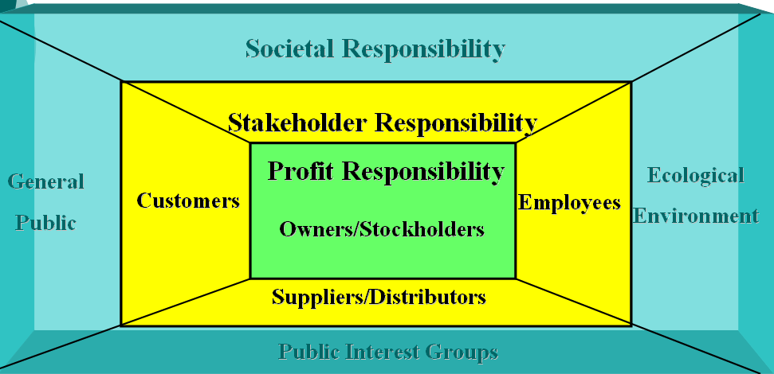
Ethics and Social Reasonability
Stakeholders of a Business

Slide 74
Stakeholders
A stakeholder is a party that has an interest in a company and can either affect or be affected by the business. The primary stakeholders in a typical corporation are its investors, employees, customers and suppliers.
Who are the stakeholders?
What responsibility does a business have to them?
VIDEOs:
Stakeholders
https://www.youtube.com/watch?v=I6SGRIwbNmg
Stakeholder Analysis
https://www.youtube.com/watch?v=LFHlal9fwkU

Slide 75

Why Should Businesses be Managed Ethically?
To maintain a good reputation
To keep existing customers
To attract new customers
To avoid lawsuits
To reduce employee turnover
To avoid government intervention
To please customers, employees and society
TO DO THE RIGHT THING!

Slide 76
Ethical Dilemmas
What type of ethical issues might you be faced with before/during the market?

Slide 77
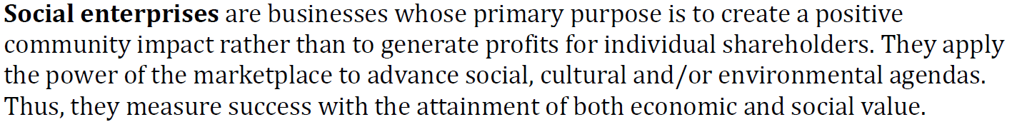
Social
Entrepreneurship

Slide 78
Hope Blooms: Halifax Kids' Winning Salad Dressing
https://www.youtube.com/watch?v=Ix2rPMz-Tz0

Slide 79
Social Funding
Social Funding Sources Assignment

Slide 80
Your social enterprise/idea
Handout
Suggestion:
Think about your field of study and decide on a business from that field

Slide 81
Proposal-handout
Task: Select a community related problem to solve.
  In-depth description of the problem
  Your proposed solution-In – depth description of how the idea will be delivered.
  What are the key roles?
  Who will be in the key roles?
  What resources do you need?
  What authorities will you need to speak with before implementing your plan?
  How long do you think it will take to see measurable changes that you because of your action plan?
What are some potential obstacles?

Slide 82
Elevator Pitch
https://www.youtube.com/watch?v=i6O98o2FRHw

Slide 83
Marketing your product

Slide 84
Marketing Process
Need
Design
Research
Name/Package/ Price
Test
Distribution?
Promote
Build

Slide 85
What is marketing?
Determining the needs and wants of others
Providing a good or service to satisfy those wants or needs
“Find a need and fill it”

Slide 86
End User Markets
Retail or consumer market – households, families
Institutional market- hospitals, schools, prisons, day-care centres
Commercial market-retailers, wholesalers, and business-to business services and the industrial market-manufacturers, processors and natural resources
Government market- municipal, provincial and federal department and agencies
Agribusiness – farms
Export market- other countries

Slide 87

Marketing – The 4 P’s- Marketing Mix
The 4 P’s are:
  Product
  Price
  Promotion
  Place

Slide 88
Marketing vs. Advertising- Don’t write this
Marketing refers to all or part of the process of conceiving, promoting, distributing and selling a product or service.
Advertising is one subset of marketing. It’s the act of bringing that product or service to the public’s attention, often through paid announcements or commercials.

Slide 89
Product Line and Product Mix
Product Line – is a group of physically similar products with similar competitors. Ex. Line of gum – bubble or sugarless.
Product Mix – combination of product lines. Company offers lines of gum and candy bars
http://www.kraftcanada.com/products
https://www.nestle.com/brands/baby-foods

Slide 90
Pricing

Slide 91
Pricing Strategies:
- Cost-plus Pricing based on cost + fixed mark-up
($ or %)
Cost + $ Mark-up = Price
($500 sofa + $300 Mark-up = $800)
This method is best used for: services, high price/luxury items, i.e. cars, furniture
Cost + % Mark-up =Price
($50 muffler + 60% Mark-up = $80)
$50 x .60 = $30 OR $50 x 1.6 = $80
$50 + $30 = $80
This method is best used for a lot of different product/services i.e. convenience store, auto parts store.

Slide 92
Pricing Determination
Cost-based pricing - producers often set the price based on the profit margin desired.
Break-even analysis - the point where net income = zero; any profit will come on sales above this point.

Slide 93
Pricing Strategies for New Products
Skimming - set the price high to maximize profits while there is no competition
Penetration Strategy - set the price low to attract customers and discourage competitors from entering the market
Price Leadership - one firm dominates the industry, sets the price and all others follow
Competitive Pricing -setting prices at the same level as those of the competition.

Slide 94
Pricing Strategies for New Products
Economy Pricing - This is a no frills low price. The cost of marketing and manufacture are kept at a minimum
Psychological Pricing - For example 'price point perspective' 99 cents not one dollar and $1.49 instead of $1.50

Slide 95
Place

Slide 96
Retailers
Who are retailers?
Distribution strategies used:
  Intensive – many places – candy, gum
  Selective – only a few stores in a market
    Appliances, clothing
  Exclusive – only one store in each market
    Auto manufacturers
Notes:
Way of competing

Slide 97
What are some modes of transportation?
How would a business choose?

Slide 98
Which transportation would you use?
Local bakery providing cakes, muffins and cookies to local stores
Medium sized Internet camera equipment store selling cameras and equipment
Large clothing chain selling clothing and accessories
Large food chain such as Kraft

Slide 99
Customer Satisfaction
How satisfied are customers?
Who are customers?
  External customers – those who buy to sell to others and those who buy for personal use.
  Internal customers – individuals and units within the organization who receive products or services from other individuals or units.

Slide 100
Location
Rent
Size of space
Nature of the space
Needs work
Parking nature of neighborhood
Competition

Slide 101
Promotion

Slide 102
There are Six TYPES OF PROMOTION used to help sellers get their message to customers.
  ADVERTISING - Any paid form of promotion (newspapers, TV, radio, magazines, billboards, etc.) usually a media involved.
  PUBLICITY - Free promotion (press releases or news reports describing how the company sponsored events or donated to a cause.)
  SALES PROMOTION - Special things done to get customers interested in trying products or to come into a store (coupons, contests, rebates, free samples, displays, etc.)
  PERSONAL SELLING - A salesperson assists each customer (a shoe salesperson helps a customer select the proper shoe size. A college student goes door to door selling children’s books.)
  ENDORSEMENT – When a famous person is paid to promote a product or service (Tiger Woods and NIKE; Tiger Woods and ONSTAR).
  PRODUCT PLACEMENT - the practice of placing brand-name items as props in, e.g. movies, television shows, or music videos as a form of promotion.
Look for the Product Placement in this clip:
  Verizon
  More Product Placement

Slide 103
There are THREE MAJOR REASONS to use promotion. They are to INFORM customers about products, to REMIND customers of the product, and to PERSUADE customers to buy. For example:
  To Inform: A TV commercial airs 10 times a day before product is released.
  To Remind: A pizza restaurant gives away free refrigerator magnets with delivery information.
  To Persuade: A company uses labels to emphasize that products are “new and improved,” “concentrated,” “extra strength,” etc.

Slide 104

Tips on Issuing Coupons
Coupons can be used as a “Thank you for buying” or a “Stop and try us.”
The value must be enough to attract customers.
Use coupon promotions sparingly.
Notes:
Also available on a Transparency Acetate
See Learning Goal 5: Explain the importance of various forms of sales promotion, including sampling.
Tips on Issuing Coupons
It’s difficult to imagine the numbers of coupons offered by companies in the U.S. market. Estimates range as high as 1 trillion. What students are not aware of is that coupons are also a significant expense to companies.
This slide offers tips to companies considering offering coupons as a form of sales promotions. Students should be able to relate to the information provided in this slide. Ask the students to comment on each of the suggestions given.
Share with the class some interesting facts regarding the use of coupons:
90% of all American adults clip and save coupons.
88% of all adults in the U.S. clip and save cents-off coupons.
88% of coupons users cited the Sunday newspaper as the best place to find coupons.
The lowest cents-off coupon adults will clip and save is 25 cents.
Families with incomes lower than $40,000 per household are more likely to clip and save coupons.
Online coupon growth has reached 27% of Internet users.

Slide 105
Examples of advertising
http://www.youtube.com/watch?v=qvlCo35lBkY
https://www.youtube.com/watch?v=fHqs_cXsxKU
Which is the most memorable, attention getting and overall best of the two?

Slide 106

4 P’s – Example
Tim Horton’s
Product Answers: What are you selling?
  Coffee and related (food, appliances, transport, etc.)
Price Answers: How much is it?
  Varies depending on product and portion size (small, medium, large)
Place Answers: Where can I buy it?
  Canadian and American locations. (hospitals, shopping malls, university campuses,)
Promotion Answers: Why should I buy it?
  Includes TV and radio spots, sporting events, community sponsorship, marketing campaigns (such as “roll up the rim to win”) etc.

Slide 107
Choose a Company
List the 4 P’s of this company

Slide 108
Your Cereal
Think of the #1 reason why they will buy your product and narrow it down to one feature or attribute that you will focus on.
This is the message you will communicate through the design of your packaging.

Slide 109
Who Will You Sell it to?
Target Market → profile who your typical customer will be.
  - Look at the entire market and divide it up until you are left with your “perfect customer”.
  - Be specific – cannot be all things to all people.
Demographics → Basic Characteristics.
  - Age - Gender
  - Income - Education
  - Family size and type - Marital status

Slide 110
Who Will You Sell it to?
Psychographics → Who they are as an individual.
  - Personality - Interests
  - Lifestyle - Hobbies
Benefits Sought → What they want to receive from consuming your product.
  - Tastes good - Health reasons
  - Fun and games - Performance/Fitness
  - Toy or special offer - Weight loss

Slide 111
Package Design
The Challenge → to combine your packaging design elements in a way that will…
  - Get your customers attention.
  - Communicate the benefit of consuming your product.
  - Appeal to them and lead to a purchase.
Elements to consider:
  - Name - Color scheme
  - Slogan - Logo
  - Pictures - Layout
  - Mascot - Special offers

Slide 112
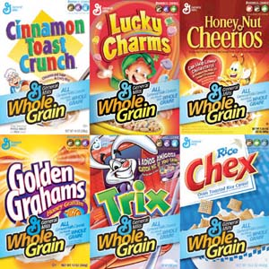

Slide 113


Slide 114
Create your Brand
Name
  The first thing the customer will read.
  Good name for food products - physical description.
Slogan or “Jingle”
  Song or tagline that people will associate with your brand when they hear it.
  Silly Rabbit…, Two Scoops of Raisins, They’re Grrrreat!, Honey of an O.

Slide 115
Create your Brand
Color
  - The most significant and defining characteristic of your brand.
  - Color creates an emotional response - different colors appeal to different types of people.
    Red – power to make decisions
    Orange – makes people hungry
    Purple – 75% of adolescents prefer purple over any color
    Green – freshness and nature
    Blue – suppresses appetite, highly appealing to men
    Yellow – Cheerful and children like it

Slide 116
Create your Brand
Sales Promotion
  Do the customers need to be given an extra incentive to buy your brand?
    Special offers, coupons, toys, mail in offers
  Is the Incentive given appropriate for your target market? Is it something they will want?
Other Things to Consider
  Use of space on the box → back of the box, inside of the box
  Layout, fonts, lettering, etc.

