Slide 1
Families in a Changing World
Unit 1 – Chapter 1

Slide 2
What is a family?
A family consists of two or more people living in the same household. They may be related by blood, marriage, or adoption.
A family may include any combination of mother, father, stepparents, children, stepchildren, adopted children, grandparents, or other relatives.
“Strengthening Family & Self”, Leona Johnson. 2010.

Slide 3
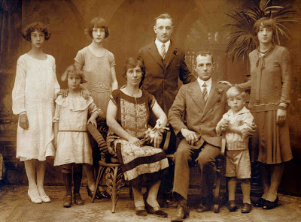
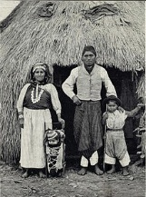
The Colonial Family
In the colonial times, the work of most families was centered around agriculture.
Families worked to obtain and own land.
All family members worked to provide for the family’s needs.
Work done by both spouses was important and necessary for the family’s survival.
Children were valuable, for they helped with chores at a very young age.
Relatives lived near by.

Slide 4
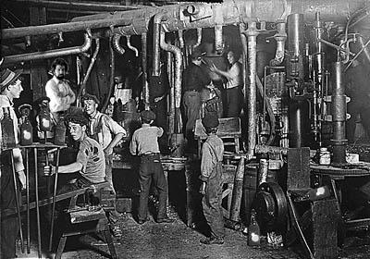
The Family During The Industrial Revolution
Many families moved from rural areas to large cities.
They found work in factories.
Families no longer worked for themselves, they worked for someone else.
They became dependent on others as they adopted the role of customers.
Large families were no longer an advantage as they no longer needed help with the farming chores.

Slide 5
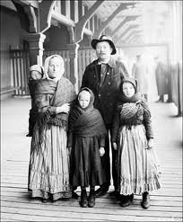
(continued…)
Parenting roles changed too:
Men worked long hours to provide for their families needs.
Women took the role of raising children as
she was the one whose full-time job
was homemaking.

Slide 6
The Family in the Technological Age
Jobs were easy to obtain.
Families bought appliances and cars to make life easier and comfortable.
The demand on family income increased which explains why many women joined the workforce.
Because many women worked, children had to play a different role as well. They shared the role with babysitters, child care workers, and teachers.
The marriage relationship changed: became based on mutual love and affection rather then a need for a person to provide for the other.

Slide 7
(continued…)
Couples who were not happy with one another would separate, and the divorce rate increased.
As a result, many families became headed by a single mother or father.
Many industrial jobs changed as computers made complex jobs simpler.
Time and energy for leisure activities became more common.
Higher education was no longer a goal just for men. It also became a priority for women
Couples divided parenting duties, child care and housekeeping tasks to balance work and home responsibilities.

Slide 8
In summary…
Family functions change in response to economic and social pressures.
Families that were self-sufficient in an agricultural economy went to work for others in an industrial economy.
The value of large families decreased. Families had fewer children and established the small-family trend that still exists today.
Today’s family faces old challenges (balancing work and family) but also faces new challenges (caring for older parents and retraining themselves to work in the computer era and a global economy).

Slide 9
Benefits of Family Living
A family can do the following:
Satisfy physical needs
Be a source of protection
Provide long-lasting relationships.
Be a source of love and affection
Provide support and encouragement.
Provide companionship

