Slide 1
Families in a Changing World
Unit 1 – Chapter 1

Slide 2
Try to answer these questions and be prepared to discuss them.
1. What is your definition of “a family”?
2. How did families change over time?
3. What do families look like today?
4. What future changes might we see in families?
5. How can families meet their members’ needs through different family structures?

Slide 3
What is a family?
A family consists of two or more people living in the same household. They may be related by blood, marriage, or adoption.
A family may include any combination of mother, father, stepparents, children, stepchildren, adopted children, grandparents, or other relatives.
“Strengthening Family & Self”, Leona Johnson. 2010.

Slide 4
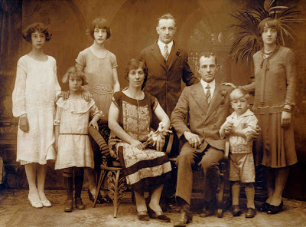
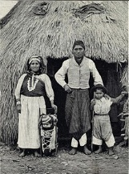
The Colonial Family
In the colonial times, the work of most families was centered around agriculture.
Families worked to obtain and own land.
All family members worked to provide for the family’s needs.
Work done by both spouses was important and necessary for the family’s survival.
Children were valuable, for they helped with chores at a very young age.
Relatives lived near by.

Slide 5
Questions…Answer on a sheet (full sentences) and hand in.
What were the advantages and disadvantages of growing up in a colonial family?
Was parenting easier or more difficult then?
Do you think children growing up in a colonial family had problems, such as establishing their identity or feeling low self-esteem? Why?
What are some examples of characteristics of families today that are similar to those of the colonial family?

Slide 6
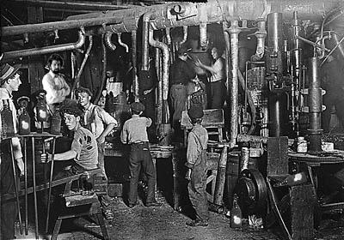
The Family During The Industrial Revolution
Many families moved from rural areas to large cities.
They found work in factories.
Families no longer worked for themselves, they worked for someone else.
They became dependent on others as they adopted the role of customers.
Large families were no longer an advantage as they no longer needed help with the farming chores.

Slide 7
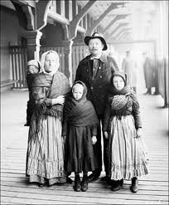
(continued…)
Parenting roles changed too:
Men worked long hours to provide for their families needs.
Women took the role of raising children as
she was the one whose full-time job was homemaking.

Slide 8
Questions to discuss in groups.
1. In what way(s) are people better off living in the city?
2. What benefits does a person lose from leaving the rural community?
3. In what way(s) was family life in the industrial revolution similar to family life today?

Slide 9
The Family in the Technological Age
Jobs were easy to obtain.
Families bought appliances and cars to make life easier and comfortable.
The demand on family income increased which explains why many women joined the workforce.
Because many women worked, children had to play a different role as well. They shared the role with babysitters, childcare workers, and teachers.
The marriage relationship changed: became based on mutual love and affection rather than a need for a person to provide for the other.

Slide 10
(continued…)
Couples who were not happy with one another would separate, and the divorce rate increased.
As a result, many families became headed by a single mother or father.
Many industrial jobs changed as computers made complex jobs simpler.
Time and energy for leisure activities became more common.
Higher education was no longer a goal just for men. It also became a priority for women
Couples divided parenting duties, child care and housekeeping tasks to balance work and home responsibilities.

Slide 11
Questions - to answer on paper and hand in for marking. (done in class) Please write questions + answers –
1. How did the increase in jobs for women affect the marriage relationship?
2. Is the overall state of marriage strengthened by this change or weakened? Why?
3. How have new technologies changed parenting roles?
4. What are some positive and negative impacts of technology on the family?
5. What resources did the colonial family have that families in the age of technology do not have? Vice Versa?

Slide 12
In summary…
Family functions change in response to economic and social pressures.
Families that were self-sufficient in an agricultural economy went to work for others in an industrial economy.
The value of large families decreased. Families had fewer children and established the small-family trend that still exists today.
Today’s family faces old challenges (balancing work and family) but also faces new challenges (caring for older parents and retraining themselves to work in the computer era and a global economy).

Slide 13
Questions…to discuss in small groups. No need for note taking during discussion.
What past changes have made family living easier or better today?
What changes have made family living today more difficult?
What characteristics in a society could promote long-lasting family relationships and develop strong ties among relatives?

Slide 14
Benefits of Family Living
A family can do the following:
Satisfy physical needs
Be a source of protection
Provide long-lasting relationships.
Be a source of love and affection
Provide support and encouragement.
Provide companionship

Slide 15
Complete the following questions and be prepared to share your responses with the class:
1. Briefly describe two major cultural changes before the technological age that affected families.
2. Review the six benefits of family living and explain them in your own words.

Slide 16
“Decades” – Poster Project Due date: (Found on outline provided)
Research what a family looked like in a particular decade (ex: 1850, 1940, etc.).
Information to include:
Family structure type and size
Family responsibilities (Gender roles - men, women, children “by age group”)
Employment (men and women)
Leisure activities (men, women, children)
Make a poster with your findings (include pictures + information on your poster). I’m looking for grade 11-12 quality work! Make good efforts.
Your name and cited sources on the back of the poster, please!
DUE: TO BE DETERMINED IN CLASS

