Slide 1
Mesopotamia
The Fall and Rise of Persia

Slide 2
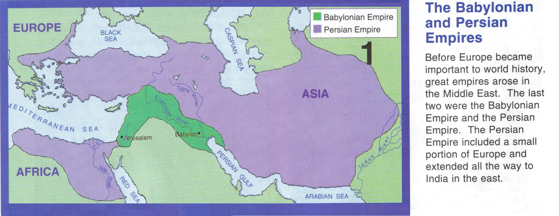
The End of Mesopotamia
Mesopotamia would eventually fall to the Persians in 539 BCE.

Slide 3
The Persian Empire
Chaldean king, Nebuchadnezzar II, rebuilt Babylon as the center of the Mesopotamian Empire and despite his reputation as a warrior king he will forever be remembered as a builder king who made Babylon one of the most beautiful cities in the world.
In 539 BCE the Persian king Cyrus led a Persian invasion on Mesopotamia and conquered Babylon.
Unlike his predecessors he showed remarkable restraint and wisdom and allowed captive Jewish to return to Israel.

Slide 4
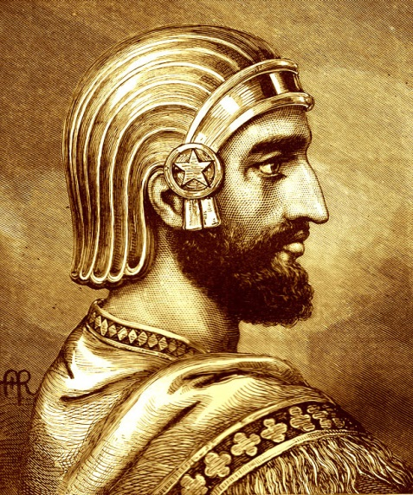
Cyrus the Great
Cyrus was a different leader of Mesopotamia as he was know for being wise and compassionate to his new empire.
He was merciful and for this the Medes(with whom he conquered Babylon), the Babylonians and the Jewish all accepted him as ruler.
Cyrus seemed to have respect for the previous civilizations as he used Assyrian, Babylonian and Egyptian designs for building his palaces.

Slide 5
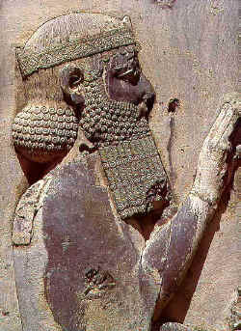
Darius 521 BCE – 486 BCE
Improves the government by dividing the empire into 20 provinces (satrapies).
The governors (satraps) collected taxes, provided justice and recruited soldiers.
After Darius, the Persian empire fizzled as kings became isolated in the now heavily taxed provinces. Because the kings were polygamous their sons often had little power but many engaged in plots to take the thrones which further weakened the monarchies until their conquest by the Greek ruler Alexander the Great during the 330s BCE.

Slide 6
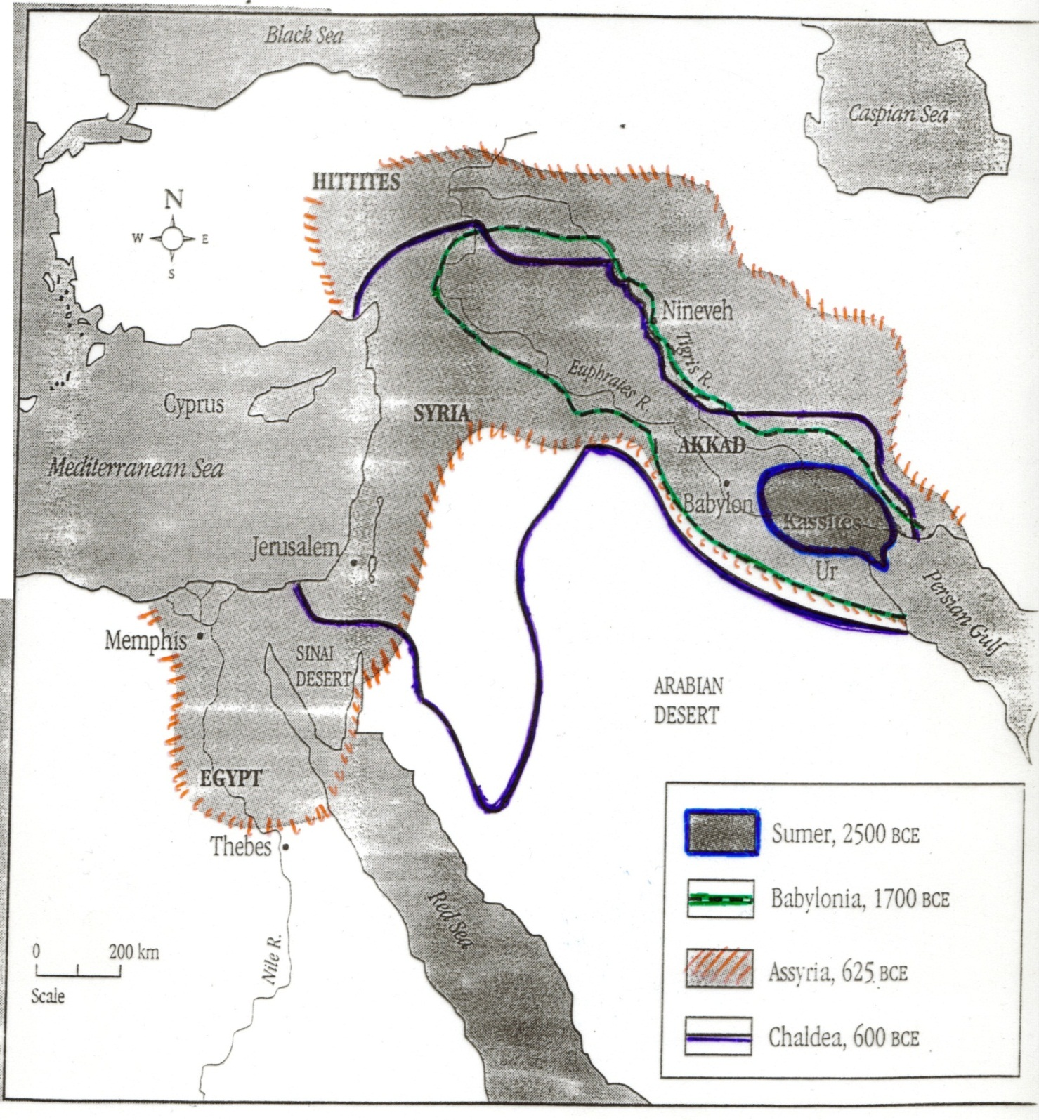

Slide 7
Major Advancements:
The Wheel | Sumerians built wheeled wagons and chariots to replace sleds. Farmers could transport more.
Metallurgy | Prior to the Bronze age, copper was used . Someone discovered accidentally you could smelt copper and tin together. Bronze is inexpensive to produce.
Mathematics | Sumerians could count in tens but preferred a unit of 60. Used to build canals keep records and for taxes.
Time | Studied the stars, divided year into 12 months, Chaldeans made calendar more accurate.

Slide 8
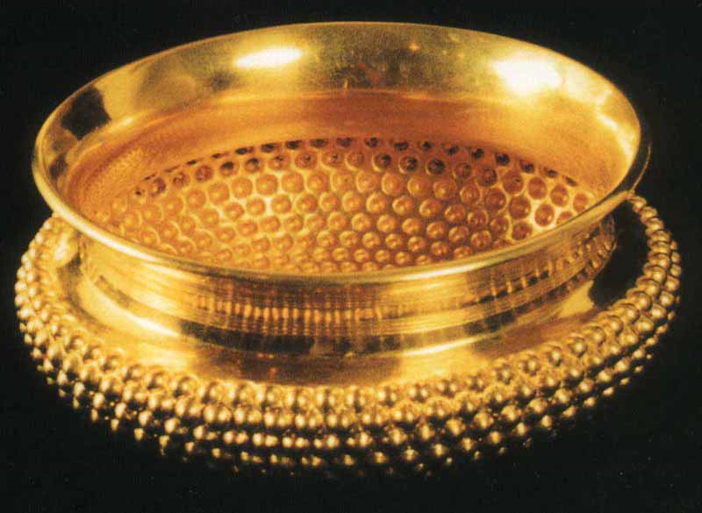
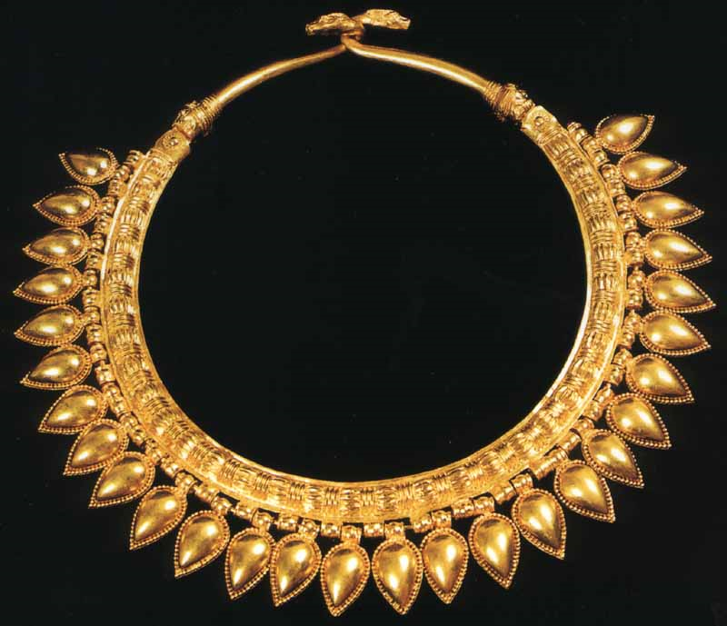
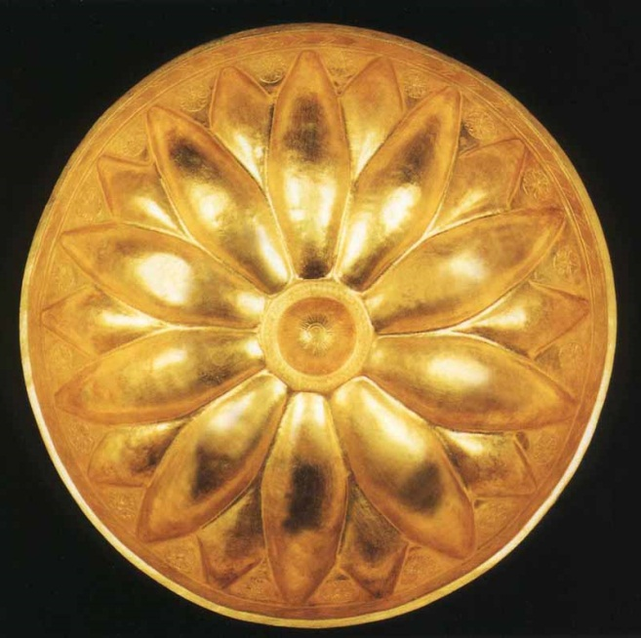
Gold Bowls & Necklace

Slide 9
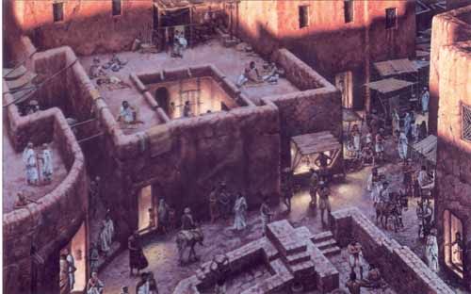
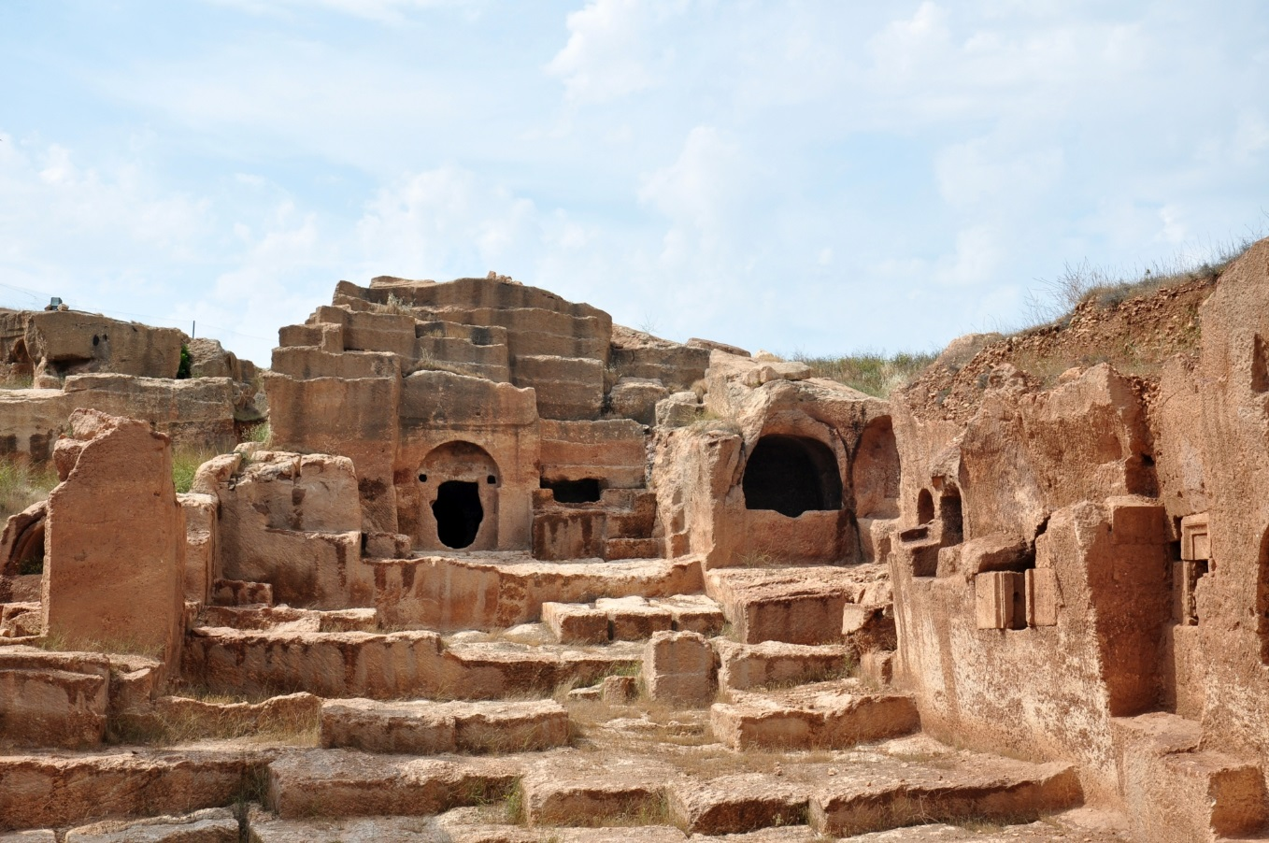
Homes

Slide 10
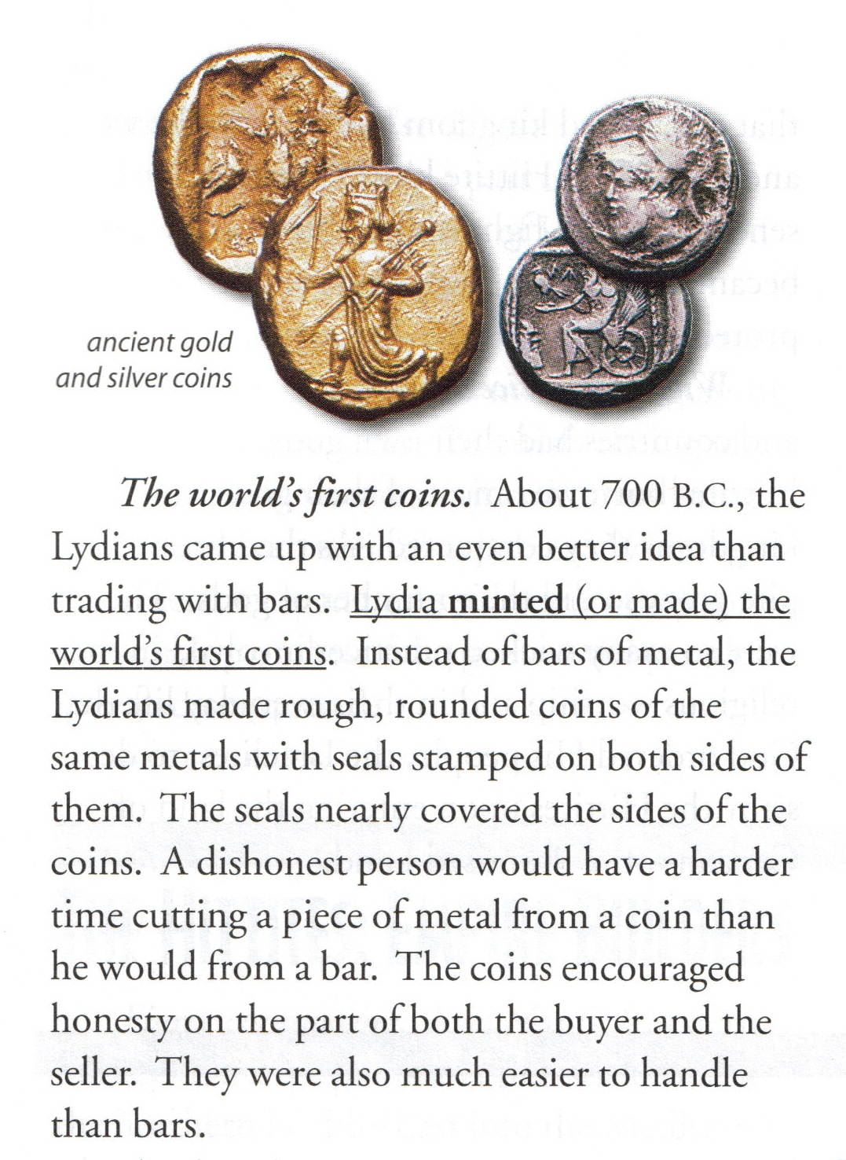

Slide 11
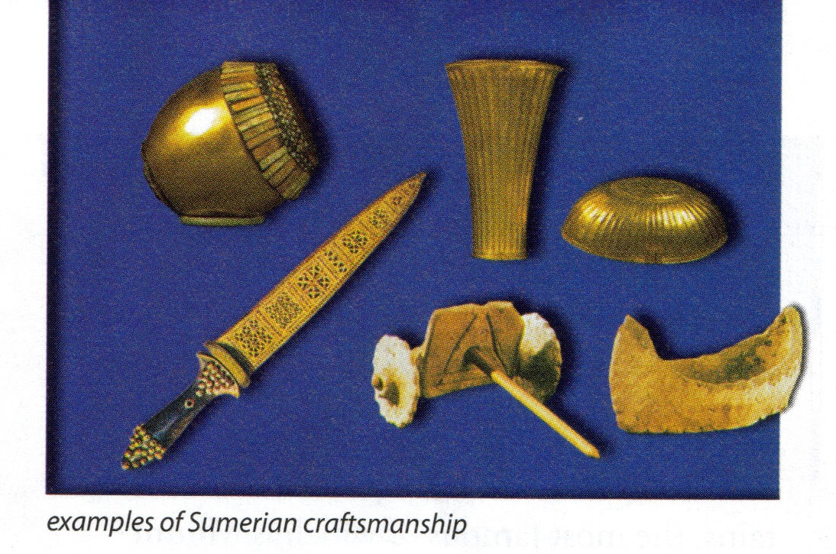

Slide 12
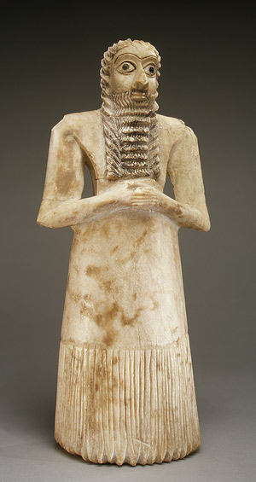

Slide 13
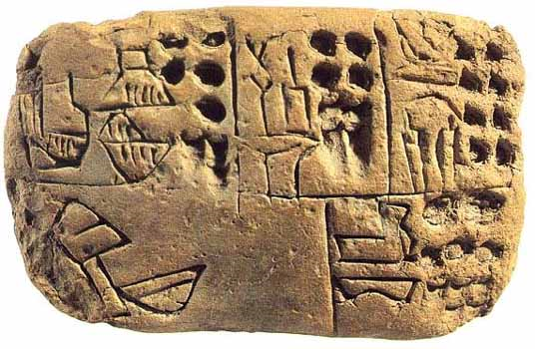
Board Game Cuneiform Tablet

Slide 15
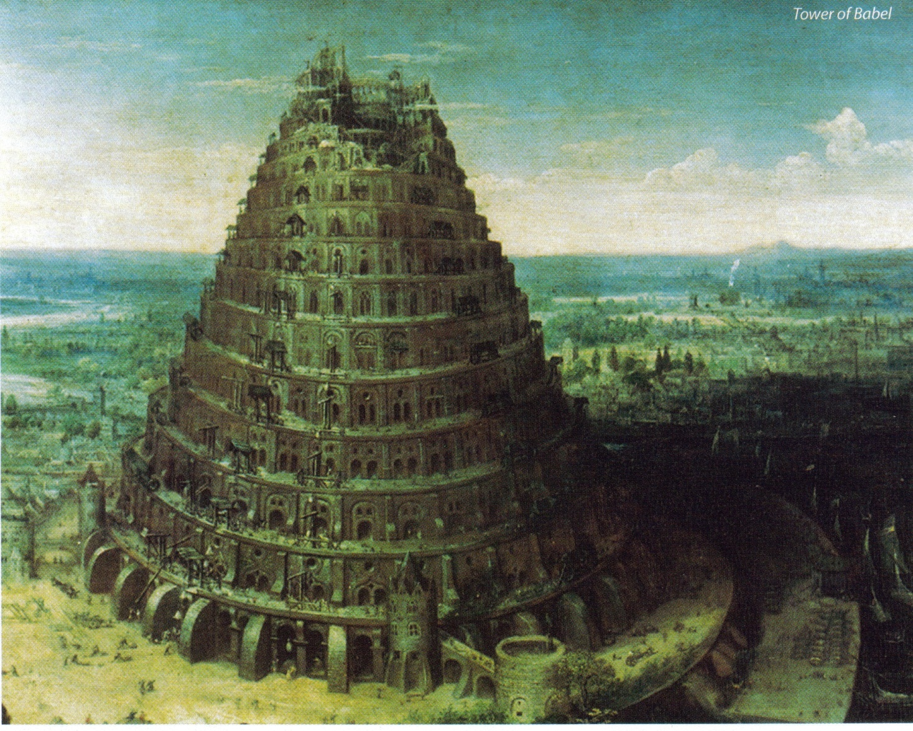
Tower of Babel

Slide 16
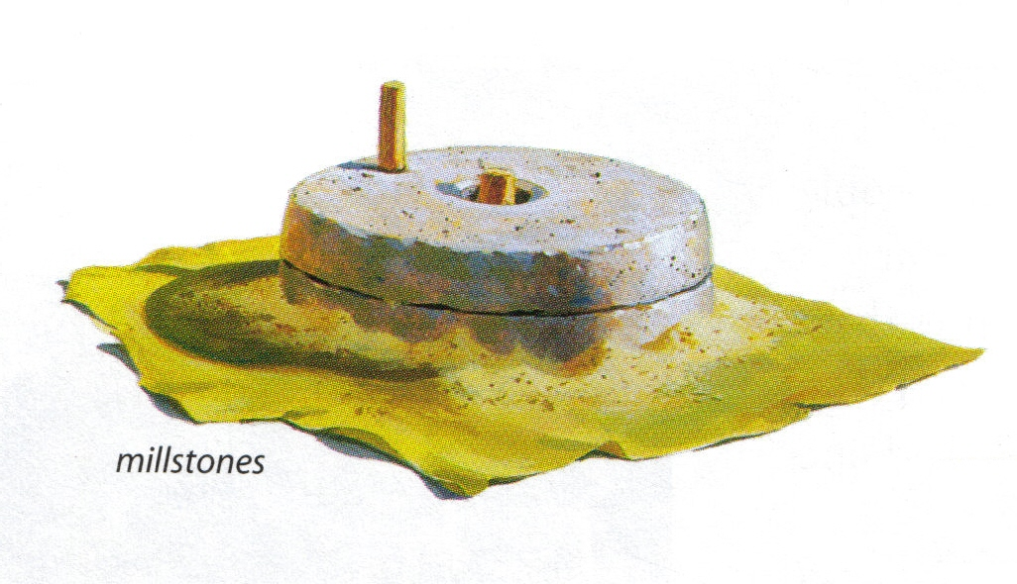

Slide 17
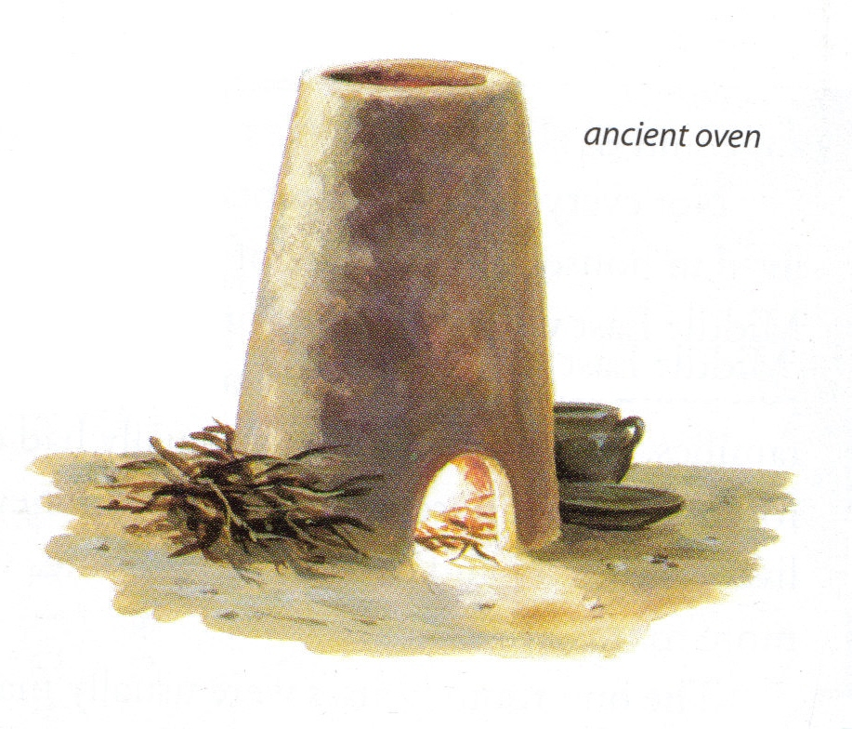

Slide 18
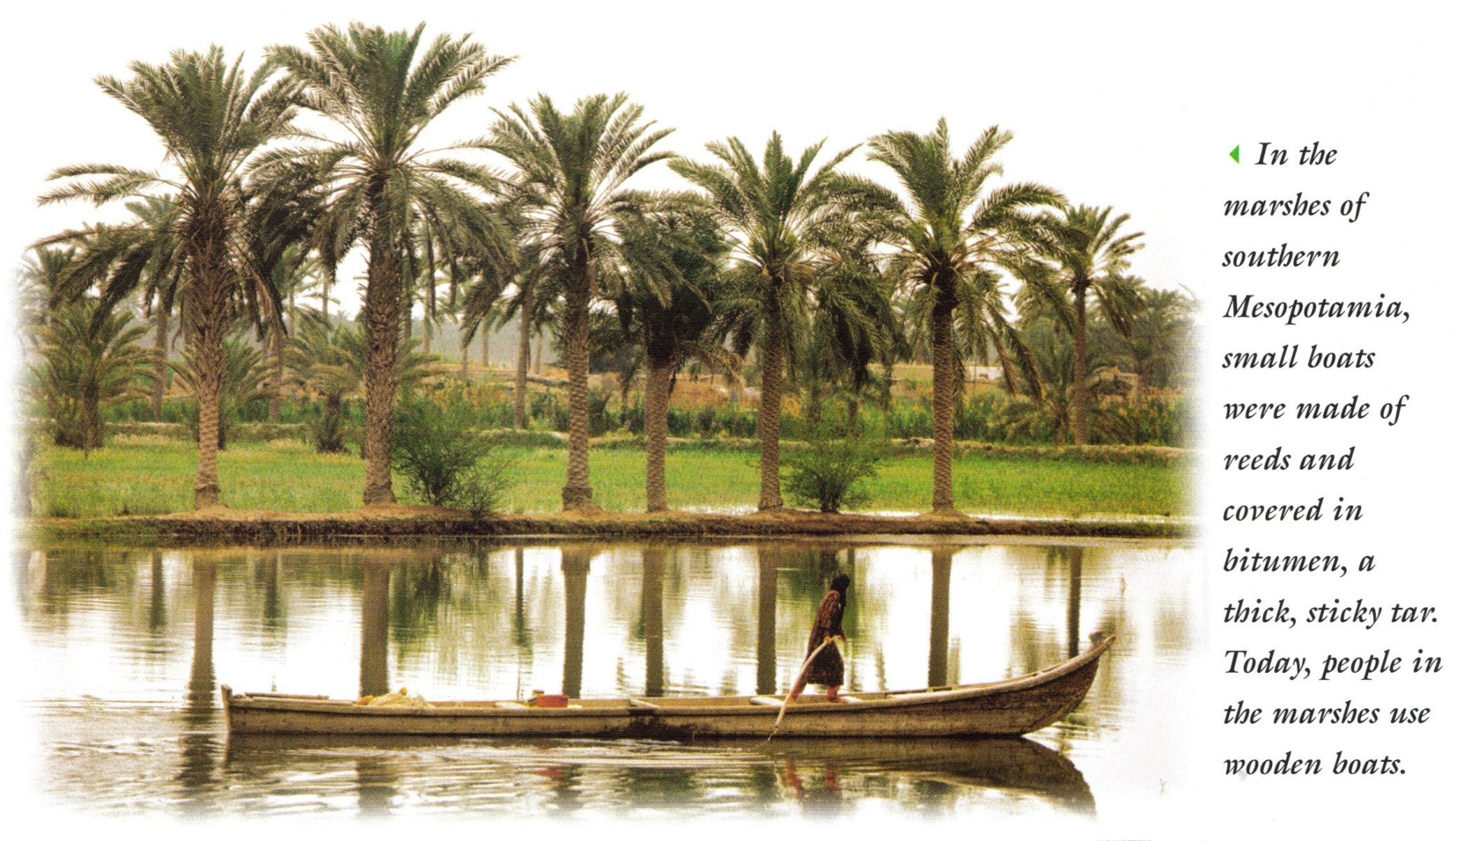

Slide 19
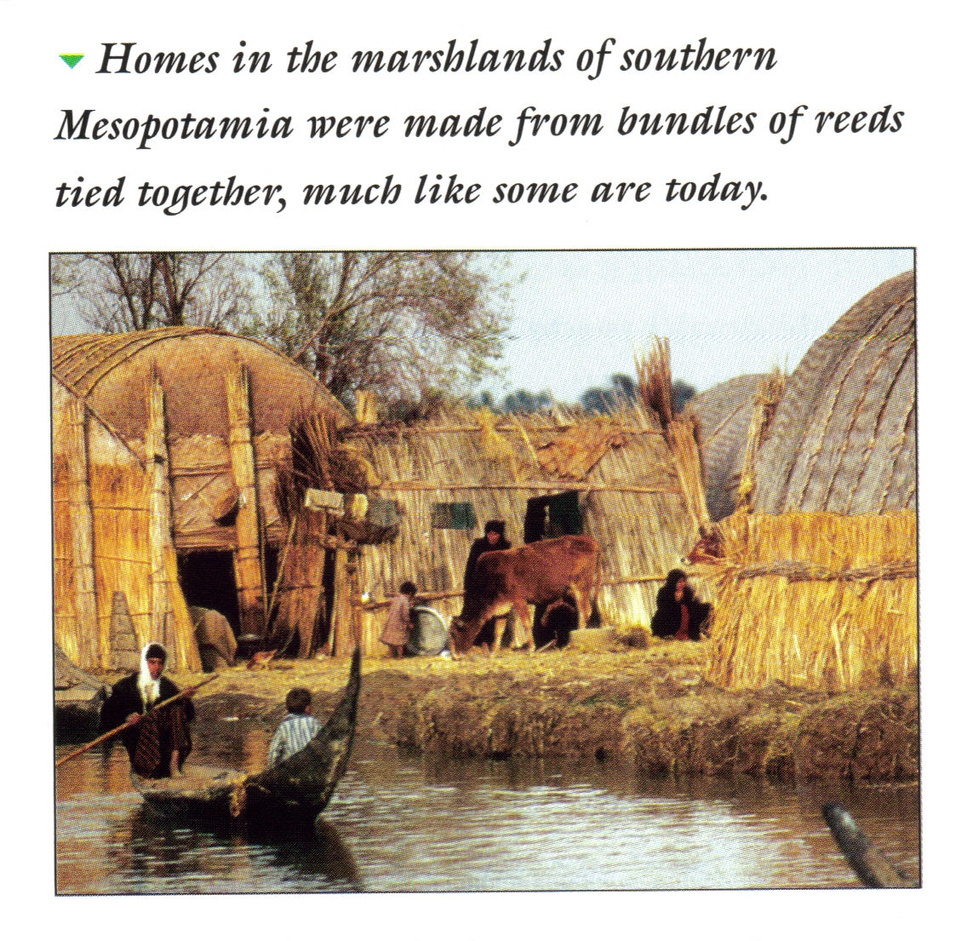

Slide 20
Mesopotamian Economy
Civilization appears when agriculture is utilized to make life easier and less dependant on hunting for food. The use of a form of writing is also used when determining what is “civilization”.

Slide 21
Why was this important?
Bronze:
used for weapons and tools
discovered by accident by smelting tin and copper together

