Slide 1
Egypt
Historical Timeline

Slide 2
TERMS:
Dynasty - a line of hereditary rulers of a country.
Monarchy - A system of government in which one person reigns, usually a king or queen.
Hieroglyphics – a system of writing developed that uses pictures to represent words and sounds.

Slide 3
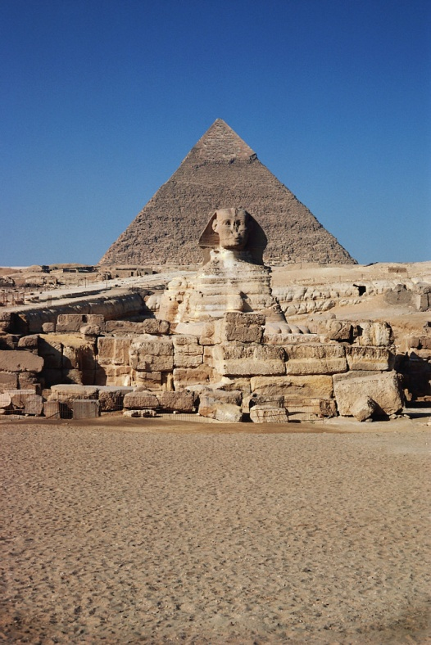
EGYPT: A HISTORICAL OVERVIEW
Predynastic Period (3100 BCE- 2650 BCE)
Old Kingdom (2650 BCE-2134 BCE)
Middle Kingdom (2040 BCE- 1640 BCE)
New Kingdom (1550 BCE-1070 BCE)
Greek Period (332 BCE- 48 BCE)
Roman Period (48 BCE-395 CE)
Notes:
Historians divide Egyptian history into three major periods of long term stability marked by strong leadership, freedom from invasion, great building projects and rich cultural activity. The “in-between’ periods were marked by political disorder and invasion.

Slide 4
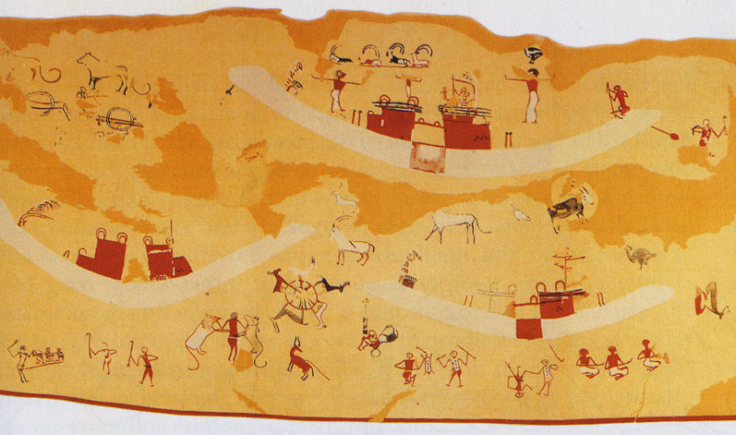
Predynastic Period (3100 BCE-2650 BCE) 450 years
Before Egypt became unified. Communities were separate but shared early forms of writing.
Archeologists suggest early Egyptians were farmers who lived in small oval shaped huts along “streets”.

Slide 5
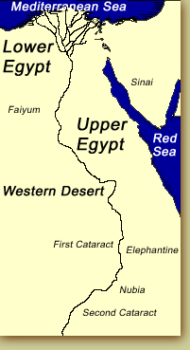
Two regions of Upper Egypt and Lower Egypt began as separate kingdoms.
The rulers of Upper Egypt wore a tall white crown, while the rulers of Lower Egypt wore a red crown.
A war was fought between the two, in which Upper Egypt won, making Egypt united.

Slide 6
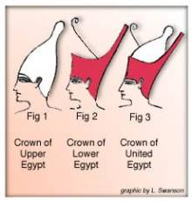
Post “War”
The king who unified the country was King Menes from Upper Egypt. He began the first dynasty.
Later rulers wore a double crown representing both regions , and became known as “Lord of the Two Lands”.
A dynasty is a sequence of rulers considered as members of the same family.

Slide 7
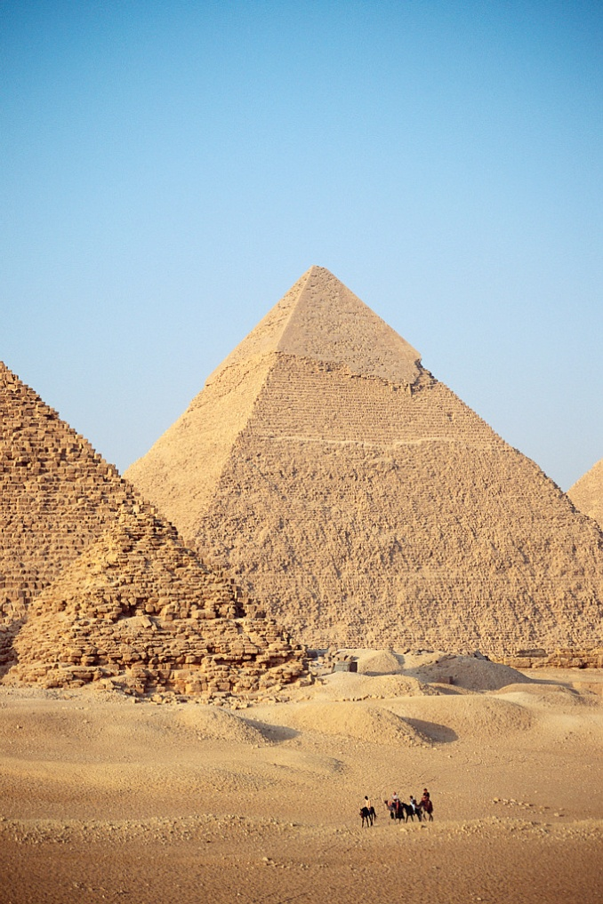
The Old Kingdom (2650 BCE – 2134 BCE) AKA “The Age of the Pyramids”
Historians often describe the Old Kingdom as “the age of the pyramids” because these structures are one of the greatest achievements of the period.
Memphis was the capital during much of this time.

Slide 8
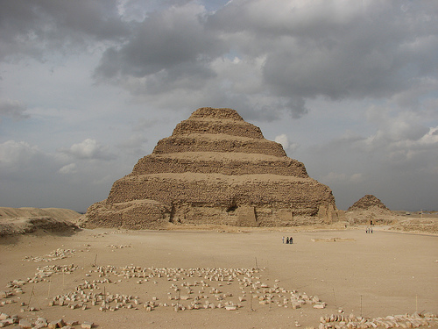
In 2650 BCE King Djoser finally created a government strong enough to command the country.
He ordered his people to construct an enormous tomb, the Step Pyramid at Saqqara. This symbolized Djoser’s power. Imhotep was the master builder of this first pyramid.
Notes:
Imhotep (c. 2667-2600 BCE) was an Egyptian polymath (a person expert in many areas of learning) best known as the architect of King Djoser's Step Pyramid at Saqqara. and he is the only Egyptian besides Amenhotep to be fully deified, becoming the god of wisdom and medicine. Imhotep was a priest, vizier to King Djoser (and possibly to the succeeding three kings of the Third Dynasty), a poet, physician, mathematician, astronomer, and architect.
Although his Step Pyramid is considered his greatest achievement, he was also remembered for his medical treatments which regarded disease and injury as naturally occurring instead of punishments sent by gods or inflicted by spirits or curses.

Slide 9
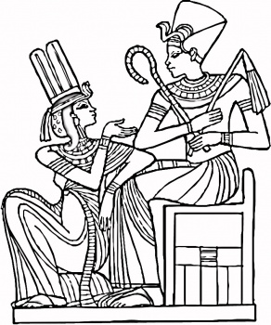
During this period Egyptians considered their rulers to be living gods. The kings became known as Pharaohs.
These kings demonstrated an attitude of being more than earthly humans by remaining distant from the general population.
Notes:
Pharaohs were monarchs and had tremendous power in ancient Egypt, they were basically seen as living gods.

Slide 10
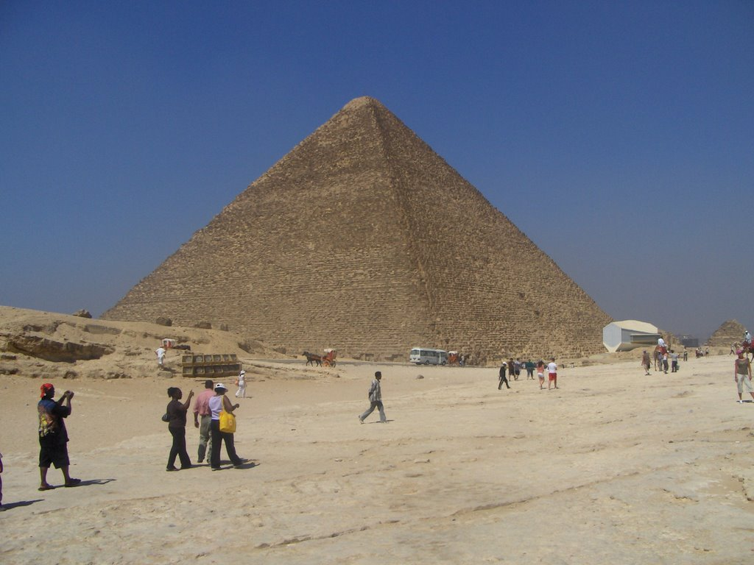
Pyramids and Tombs
During this period the largest and most magnificent of the pyramids were built under King Khufu.
The Great Pyramid of Giza was build around 2540 BCE and was nearly 500ft high and each side at the base measured 756 ft.
Notes:
Herodotus reported that it took 100,000 Egyptians 20 years ti complete the Great Pyramid. Keep in mind that Herodotus wrote about this event 2000 years after this pyramid was constructed.
The pyramid was constructed so precisely that a single hair cannot be pushed into the joints between the stone slabs on the outside of the pyramid.

Slide 11
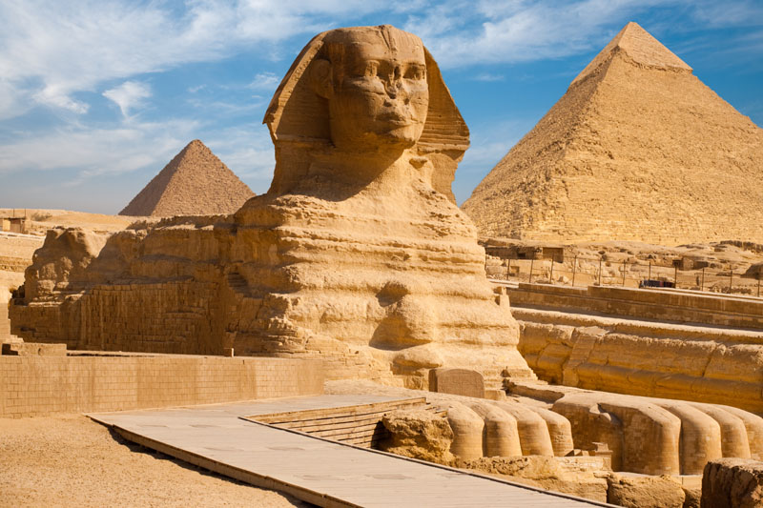
Symbols of Power
King Khufu’s son, Khafre, was responsible for the construction of the Great Sphinx which stands not far from the base of his fathers greatest symbol of power and wealth.
Notes:
Although historians don’t know for sure it is believed that the Sphinx is important guardian of sacred sites for ancient Egyptians.

Slide 12
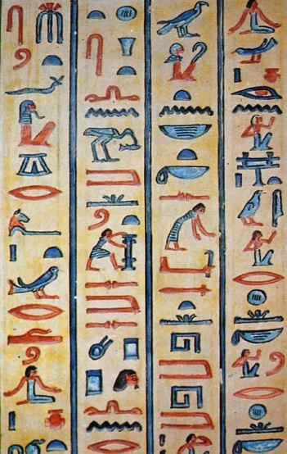
ACHIEVEMENTS of the Old Kingdom:
Hieroglyphics are improved
The foundation for organized government are laid
Trade and farming were govt. regulated.
At the end of this period, Egypt suffered many years of droughts and famines and the Pharaohs lost authority. This period lasted about 10 years.

Slide 13
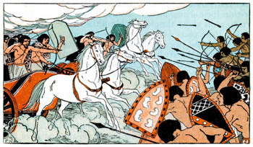
The Middle Kingdom (2040 BCE-1640 BCE)
Egypt began to prosper again. Architecture, literature, and the arts flourished in this period.
Nobles of the Middle Kingdom maintained their own permanent armies.
These armies were sent south to conquer Nubia and North to Palestine and Syria.
Trade with Crete, Mesopotamia and Syria helped Egypt prosper.
Notes:
This was the Golden Age of stability for Egypt.

Slide 14
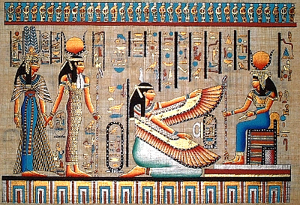
The leaders of Egypt now were less “living gods” and looked to help the common people.
Middle Kingdom Pharaohs were responsible for draining the swamplands of the Nile Delta which provided more farmlands and a new canal connected the Nile to the Red Sea.
A great number of people from other lands settled from outside of Egypt, and soon took power. They were known as Hyksos kings and marked the start of the New Kingdom.
Notes:
The Hyksos kings were from western asia, probably Syrian. They overwhelmed the Egyptians with horse drawn war chariots and bronze weapons.

Slide 15
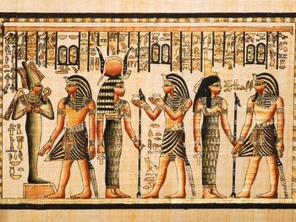
The New Kingdom “ The Age of the Empire” (1550 BCE- 1070 BCE)
During this period, Egypt became the strongest empire in the ancient world.
They were determined that Egypt never fall into the hands of foreigners again.
Pharaohs during this time increased the size of their armies.
Notes:
During the start of the New Kingdom the Hyksos kings still ruled for nearly 100 years but during that time the Egyptians learned new skills and mastered new techniques from the foreign rulers. They rose in power and eventually drove out the foreign rulers and a new kingdom was established.

Slide 16
Hepshepsut and Ramses II handout.

Slide 17
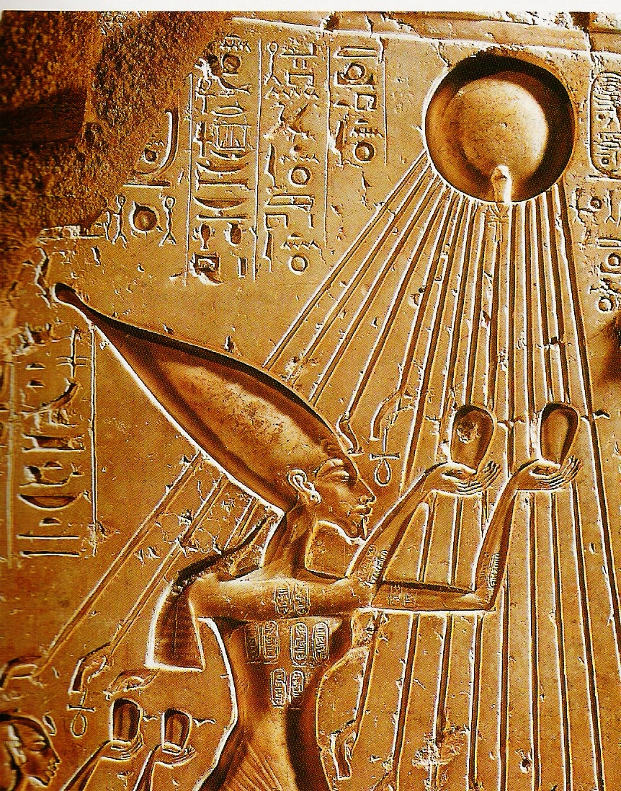
While the New Kingdom was a time of strong leadership there were moments of poor decisions.
Amenhotep IV(1352-1336BCE) introduced the worship of Aten, god of the Sun Disk, as a sole god. This new change disrupted a belief system that dated back for centuries and challenged old traditions.
Notes:
Amenhotep changed his name to Akhenaton

Slide 18
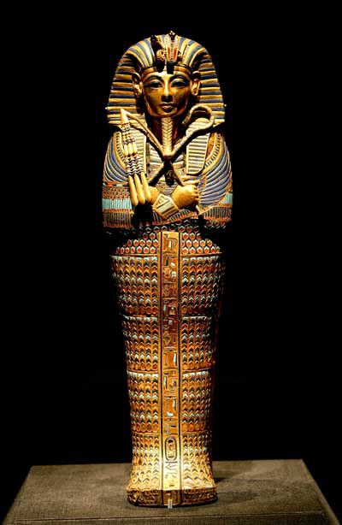
His preoccupation with religion led to his downfall despite an outpouring of art.
In 1336 BCE the new King, Tutankhamen, restored the old beliefs and allowed Aten to be worshipped as well.

Slide 19
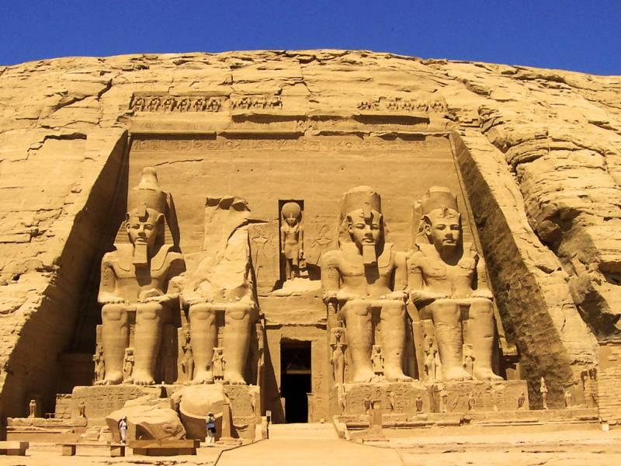
The end of the New Kingdom stared between 1070 BCE – 332 BCE as internal struggles for royal power increased and ultimately led to new smaller states and not a true empire.
Over the next 700 years 10 different dynasties ruled Egypt, including Nubian, Assyrian, or Persian rulers.

Slide 20
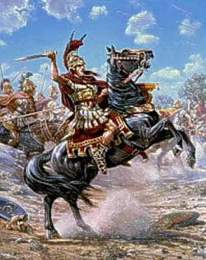
The Greek Period (332 BCE-48 BCE)
In 332 BCE, the Macedonian armies of Alexander the Great began to rule Egypt.
Greek became the language of government in Egypt for almost a thousand years.
Macedonian kings had “sister-wives” called “CLEOPATRAS”.
Notes:
During this period Alexandria became the most brilliant metropolis in the Greek speaking world. The Ptolemies (a line of Greek Egyptian Kings) increased foreign trade and developed Egypt’s natural resources.

Slide 21
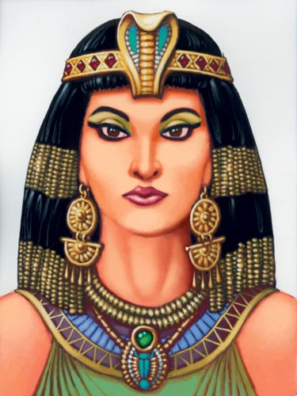
The Roman Period (48 BCE- 395 CE)
Cleopatra VII formed an alliance on two separate occasions with Roman leaders. First with Julius Caesar and then with Mark Anthony.
Eventually Cleopatra and Mark Anthony were defeated by Octavian (Caesar’s nephew) and Egypt became a province of Rome.
Notes:
Cleopatra VII (51 BCE – 30 BCE) and her two brother fought for control over Egypt and attracted Rome’s attention.

