Slide 1
Government and Social Structures in Ancient Egypt

Slide 2
TERMS
Pharaoh – the title given to the rulers in ancient Egypt.
Nomes – the provinces into which ancient Egypt was divided.
Nomarch – the official who governed a nome (province) in ancient Egypt.

Slide 3
Government and Social Hierarchy

Slide 4
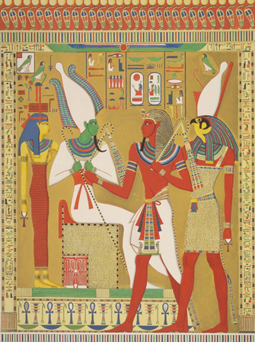
Pharaoh
Pharaoh comes from the Egyptian word meaning “Great House”.
They were thought of as a descendant of the sun god.
Notes:
Ancient Egyptians looked upon the pharaoh as a living god, a descendant of the great sun god Re. They also believed that Horus, a powerful sky god, represented as a hawk, entered the Pharaoh when he/she sat on the thrown. After death the deceased pharaoh was referred to as Osiris, god of the dead.
Pharaoh’s often acted very much like the Nile river, calm and steady. They were not tyrants like other rulers that were found in placed like Mesopotamia.

Slide 5
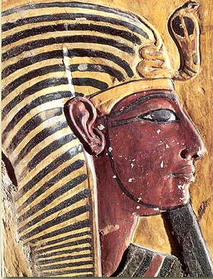
The Pharaoh
The position of pharaoh was passed to the eldest son of the king’s chief wife.
Some “chief” wives gave birth to only daughters, and several of them claimed the throne.
Some pharaoh’s had several wives who were called lesser wives.
Notes:
At least 4 women ruled ancient Egypt

Slide 6
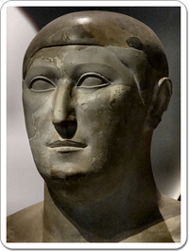
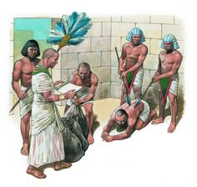
The Vizier
The highest ranking official, the vizier, served as the pharaoh’s deputy in all affairs of the state.
They were in charge of collecting taxes, overseeing judges, scribes, and government officials, a job that became very difficult so a second Vizier was needed, one from upper and one from lower Egypt.
Viziers were often a prince of royal blood.
Notes:
The viziers were often appointed by the pharaoh. During the Old Kingdom Viziers were exclusively drawn from the royal family, while from the period around the reign of Neferirkare Kakai onwards, they were chosen according to loyalty and talent or inherited the position from their fathers.
The viziers were appointed by the pharaohs, but often belonged to a pharaoh's family. The vizier's paramount duty was to supervise the running of the country, such as a prime minister, at times even small details of it such as sampling the city's water supply.
(Top Pic) Hemiunu (fl. 2570 BC) is believed to be the architect of the Great Pyramid of Giza, Egypt. As vizier, Hemiunu was one the most important members of the court and responsible for all the royal works.
Perhaps the most famous vizier was Imhotep who served under the 3rd dynasty Pharaoh Djoser. He is credited with designing and building the Pyramid of Djoser; the first step pyramid. His talents were numerous and he was one of the earliest architects and engineers in history.

Slide 7
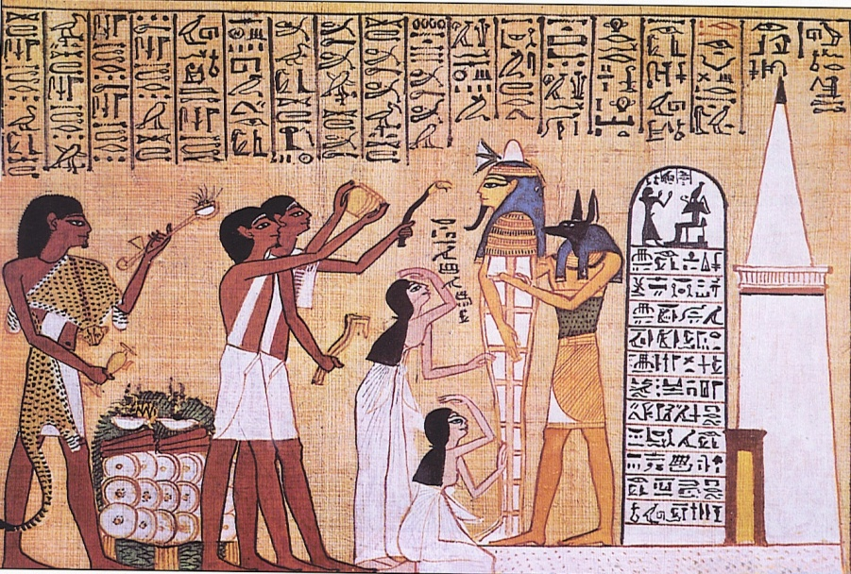
Overseer of the treasury
Worked directly under the vizier.
Overseers kept track of taxes and tributes.
Taxes were often collected in the form of crops (from farmers) and goods (from skilled workers). So the treasuries were often warehouses.
Notes:
Due to the requirements of Overseers they often had to work closely with other overseers of cattle and granaries.
The treasury was the place in the royal palace where precious materials were stored, such as metal objects, but also linen. Therefore, the overseer of the treasuries was basically responsible for administrating the resources of the country

Slide 8
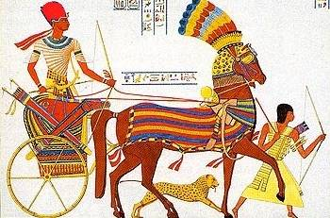
Army commanders and governors
The Commanders controlled the army and conquered territories.
The Governors would then rule the newly acquired territories and regulated soldiers who kept the conquered people in check.
Notes:
The General of Armies advised the Pharaoh on matters of war and securing the ancient Egyptian civilization.
This advisor was the top military commander.
This government position was extremely important throughout ancient Egypt's history due to the fact that this civilization was often expanding its borders through warfare and was often threatened by outsiders.

Slide 9
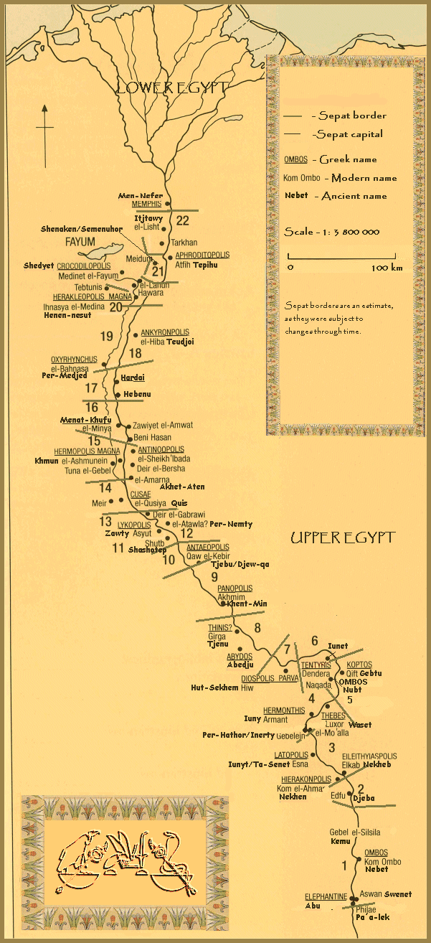
Nomarchs
Ancient Egypt was divided into 42 provinces called nomes.
Each of these territories were governed by an official called a nomarch, appointed by the pharaoh.
Notes:
Nomarks were sometimes appointed by the Pharaoh, while at other times the position of nomarch would be hereditary and handed down from father to son.

Slide 10
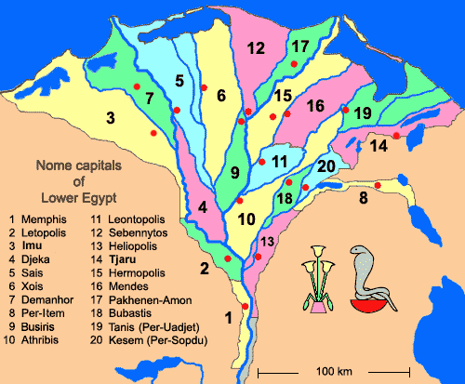

Slide 11
The nomarch was responsible for: collecting taxes, keeping law and order, raising troops in time of war, and organizing workers.

Slide 12
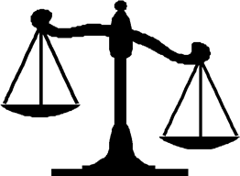
Egyptian Law
They did not have an extensive codes of law.
Priests, soldiers or government officials presided over local courts.
Penalties for crimes included physical punishment, from community service to beatings, to death.
**If the guilty person ran away, their family would be taken instead.
Notes:
In villages many courts dealt with a wide variety of general matters and local land owners were expected to sit in judgment when called upon. Each nome had a high court where more important cases were heard. For major crimes, like treason, a special commission might have been appointed to prosecute the case.

Slide 13
Questions to Consider
What could be seen as the advantages and disadvantages of this system of government?
Why do you think bureaucracy became more complicated in the Middle and New Kingdoms?

